Slide 1
Spandex Health monitor
Let’s continue to entertain, but allow ourselves to live a healthy life after we retire.
By: Dwayne Carolina

Slide 2
Who Could utilize this?
Football Players
Basketball Players
Wrestlers
Hockey Players
Nascar Drivers

Slide 3
What is the potential uses?
This spandex Health Monitor, will be a full body suit and it will send feedback to a computer at the sideline of the court/field about the heart rate, foot pressure and other physical stats on each player.

Slide 4
Where would this be used?
This would be used in sports stadiums.
This will be used as a full body suit.

Slide 5
When would this be used?
During anytime of physical collisions sports or forms of entertainment.

Slide 6
Why would this be useful?
This is my project Proposal because there is a lot of passion in entertainment sports and sometimes players go out to entertain and they have a concussion or are dizzy and they won’t admit it because they feel like they have to go out there for the love of their sport and the entertainment of their fans.

Slide 7
How will this be used/useful?
This will be used by a spandex suit fitted to each players body, the suit will have sensors inside and the sensors will send feed back to computers at the side of the court/field so people can know of any occurring physical stats on entertainers/players.

Slide 8
Inspirations?
I was inspired to do this after I read articles on how many young athletes die every year from concussions and other injuries that aren’t attended to with the proper response.

Slide 9
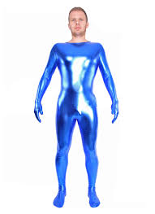
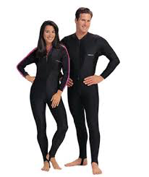
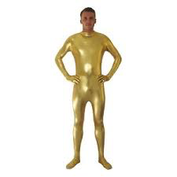
Visual Aid

